Slide 1




Engineer Internship Presentation
referential open data and price classification
Done by : Mouna ALOUI
Interning at : GeeksDATA Consulting
Supervised by: M Aymen Khelifi
Duration: From 17/07 to 17/08
University Year : 2019/2020
Notes:
Good morning every body . First I want to thank you all dear jury members for giving me this opportunity to present my engineer internship project untitled : referential open data and price classification, which has been done with geeks data consulting supervised by M. Aymen Khelifi from 17 June to 17 August 2019

Slide 2
OUTLINE
Introduction
Company background
3 About the project
4 Strategy and project management
5 Steps and tasks performed
6 Challenges faced & Learning outcomes
7 Conclusion
2
Notes:
Firstly, I'm going to begin with an introduction to present the company background and , its fields of expertise and the objective of my project named referential open data and price classification. Secondly I will describe the strategy and project management. After that I will enumerate the stpes and tasks performed as well as the challenges faced. At las but not least I will specify the learning outcomes, and to finish with a conclusion and perspectives.

Slide 3
1. Introduction
3
Notes:
So, As an engineering student at SUPCOM in my second year we are asked to pass engineer internship in order to apply our technical skills learned during the whole year and why not to discover other new technics,
It is a training course in the company. It will allow the student to implement the knowledge acquired during his schooling to drive, present and carry out a solution to meet the demand of a business,
And I spent 9 weeks from 17 June to 17 August at Geeks DATA Consulting as junior data scientist intern.

Slide 4
2. Company
Background
4

Slide 5
Its origin:
Areas of expertise
Text mining/data mining
Recommandation system
Data analysis
GeeksData Consulting is a subsidiary of the French company KaizenData which is a consulting firm in Big data and data science
Its service
Organizational structure
It offers a general approach to customer relations to better meet the expectations and issues of its customers.
Commercial team
Technical team
5
Notes:
Let’s begin with It’s origin, in fact GeeksData Consulting is a subsidiary of the French company KaizenData which is a consulting firm in Big data and data science.
It offers a general approach to customer relations to better meet the expectations and issues of its customers.
It’s area of expertise are data mining , recommendation system and data analysis.
And it is composed of a commercial team and a technical one

Slide 6
3. About the project
6

Slide 7


3. About the project (1/2)
In business intelligence, decision makers nowadays aspire to know how a project on which there’ve been lots of investments will behave, how their money will come back, they need a Crystal Ball to see the impact of their investments in the future
7
Notes:
1* In business intelligence, decision makers nowadays aspire to know how a project on which there’ve been lots of investments will behave, how their money will come back, they need a Crystal Ball to see the impact of their investments in the future.
2* Making these decisions will be influenced by several conditions and elements, direct and indirect reasons:
3* The problem is that we are not conscious enough about the degree of the effects of these external elements on the product’s price

Slide 8
3. About The project (2/2)
Objective:
creating a chain for economic decisions makers to classify the price of a certain product and analysis the different features and external element that could change this price
Climate open data .
Economical features
Making decision
data analysis
8
Notes:
So, my project comes in this context, creating a chain for economic decisions makers to classify the price of a certain product and analysis the different features and external element that could change this price after collecting climate open data and economical features, analyses all these data then use some Machine learning algorithm to make decision

Slide 9
4. Strategy and project management
9

Slide 10
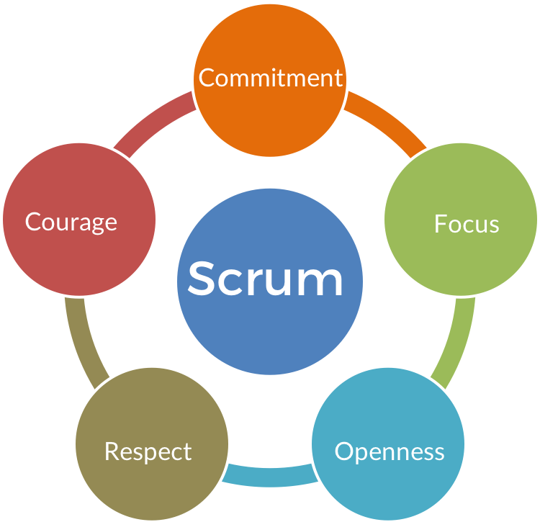
We have daily scrum by fixing objectives in the morning then we make a short report of advancement at the end of the day
The coordination is made through skype texting and emailing for the daily scrum, and by skype calls with screen share for the weekly sprints.
We fixed a sprint of 1 week in which the supervisor makes an overview on the entire work of the week
Redmine platforme to manage tasks
10
Notes:
During my internship, the project management approach we adopted in order to meet goals in time and have a suitable supervision is” Scrum” methodology

Slide 11
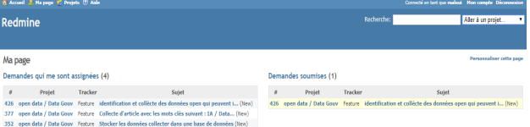
Redmine platform for project management
11

Slide 12
5. Steps and tasks performed
12

Slide 13
5. Steps and tasks performed (1/4) :
Referential open data using public source data
Task 1 Data extraction by different procedures
1. Climate measures:
Downloadable from NCDC website
Using an API : weatherstack
13
Notes:
My project is composed from 2 parts :
First data extraction from public source by different methods and procedures
We have concentrated on two types of public data: at the first stage the climate measures by two different methods ;
1 from the NCDC website that centralizes all climate measures in the world and others it as open public data.
2 and then from the weather stack API using get requests

Slide 14
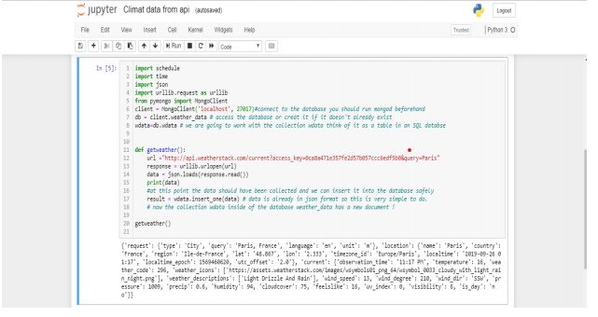
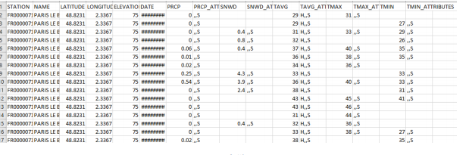
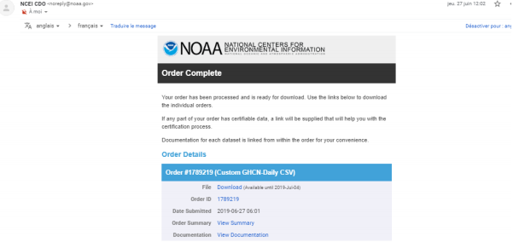
14

Slide 15

5. Steps and tasks performed (2/4) :
Referential open data using public source data:
exchange Currency using exchangesrates api
15
Notes:
The second type of data s the economical indicators : and priceasly the currency exchange means how currency changes form one to other per day

Slide 16

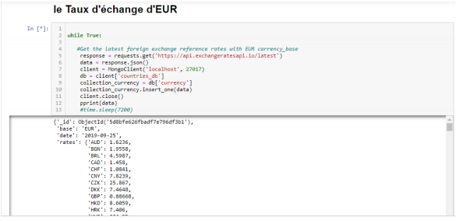
16

Slide 17
5. Steps and tasks performed (3/4) : price classification
Import data : smartphone dataset
data has been imported from internet in order to build the model at first
01
02
Training the data
applying some feature engineering and analysis data using xgboost and svm algorithms
Test the moedel
Testing data and that give me an accurancy much more better with xgboost then SVM
03
04
Laptops dataset
Repeat the same steps with the laptop dataset
17
Notes:
In machine learning and statistics, classification is a supervised learning approach in which the computer program learns from the data input given to it and then uses this learning to classify new observation.
In my project I’m going to focus on the smartphone price classification We will classify the price of smartphone into 4 different classes: 0,1,2 and 3 means: price: low, medium, high and very high respectively Dataset has been downloaded from internet containing 21 features:
First I imported the data: a dataset of smartphone prices and its characteristics from internet containing 21 features.
After that we come to the training step using both svm and xgboost algorithms , then test the model to finally obtain 89% and deduct that xgboost is much more better then svm

Slide 18
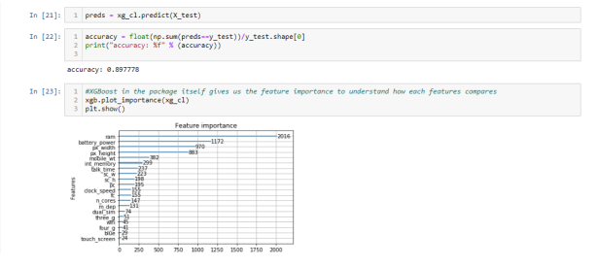
18

Slide 19



5. Steps and tasks performed (4/4) : implementation part
19

Slide 20
6. Challenges
faced
and learning
outcomes
20

Slide 21

Challenges faced:
Initially, it used to take much more time in looking up for the data then it actually should have taken. But it improved with practice.
Facing time constraint and finishing tasks before the deadline
Learning new concepts from 0 and searching for reliable sources
Working with algorithms of machine learning and differentiate between them
21

Slide 22
Learning outcomes:
01
04
Increasing speed and accuracy for collecting and analyzing data by using different technical tools
Working within a team
02
Project management and respecting deadlines
05
To deepen my skills in a field that fascinates me Very much
03
To learn how to take responsibility
and to make me feel better
in the case difficulties and gaps
06
Machine learning tools
22

Slide 23
7. Conclusion
23

Slide 24

How can I evaluate my project
“The difference between ordinary and extraordinary is that little extra.”
― Jimmy Johnson
It was a nice professional experience, I have learned many technical skills and I have been able to pass some stages successfully, finishing my work before deadlines and assuming responsibilities makes me feel proud and able to go more and keep working to reach better results.
our model could be much better if I had enough time to use data collected in the first step (climate and economical) and try to collect some events that could influence the product price.
24

Slide 25
References :
➢ Climate data
https://weatherstack.com/
➢ economical data:
https://exchangeratesapi.io/
➢ Machine learning definition: https://www.expertsystem.com/machine-learning-definition/
➢ product prices:
https://www.kaggle.com/
➢ SVM model architecture on: https://www.google.com/url?sa=i&source=images&cd=&cad=rja&uact=8&ved=2ahUKEwjJzdT5q6jiA hUHThoKHQNrB40QjRx6BAgBEAU&url=https%3A%2F%2Fwww.saedsayad.com%2Fsupp
25

Slide 26
Thank You
26

